Slide 1

Object Selection
_______________________
_______________________
Student:
Nguyen Van Khoi
Tran Hoang Nam
Supervisor:
MSc. Tu Trung Hieu

Slide 2
Introduction
Literature review
Problem statement
Interactive graph cut segmentation
Silent Lazy Snapping solution
Experimental results
Future direction
Question and answer

Slide 3
Image selection
An image is a set of sub-images that sometimes referred to as regions-of-interest, ROIs, or simply regions.
One of the problem in image processing is image selection – how to cut out or select an area for later specific image processing operations.

Slide 4
Interactive single-image segmentation
Interactive single-image segmentation (image cutout or foreground/background separation), one of the typical case in region selection problem, is to select the object (e.g. human, flower) from the background that based on samples provided by the user.

Slide 5
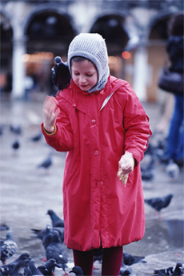
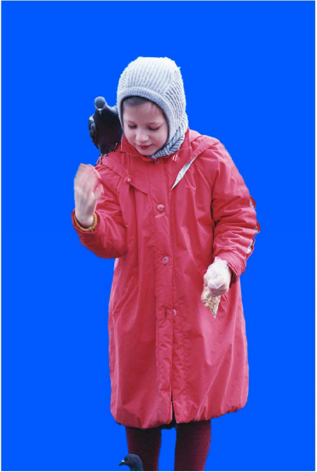
Image segmentation from Lazy Snapping paper

Slide 6
Introduction
Literature review
Problem statement
Interactive graph cut segmentation
Silent Lazy Snapping solution
Experimental results
Future direction
Question and answer

Slide 7
Graph cut for Interactive Segmentation
Based on the works of Greig et al., Exact maximum a posteriori estimation for binary images, 1989.
Region-based method
Constructing graph from image at pixel-detail level
Energy function combine both region and boundary properties

Slide 8
Lazy Snapping (Microsoft Research Asia - 2004)
Goal: separate object from background
First step: foreground/background selection
Sample are given by users in each part of image (draw strokes)
Solve minimum cut problem on segment level
Second step: boundary correction by Overriding brush or Direct vertex editing
User provides some strokes on incorrect parts of object
Solve minimum cut problem on pixel level

Slide 9
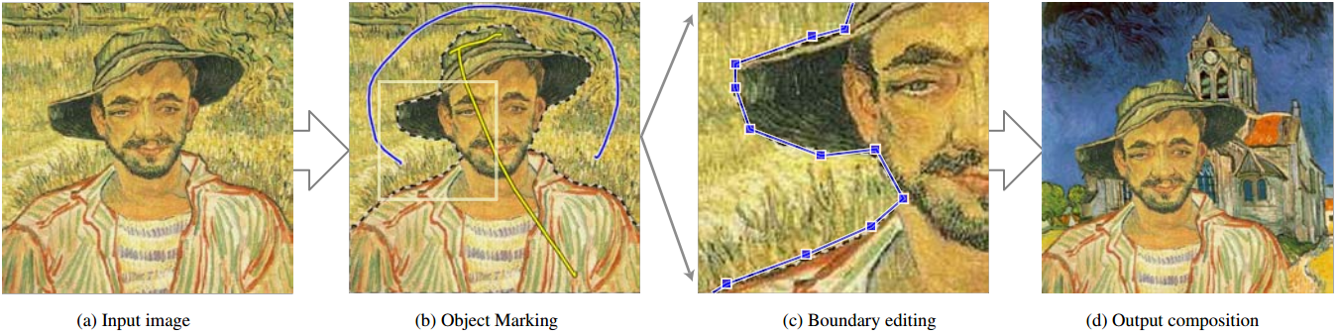
Lazy Snapping samples

Slide 10
GrabCut (Microsoft Research Cambridge – UK – 2004)
Goal: separate object from background
First step: foreground/background selection
Sample are given by users in each part of image (lasso, rectangle bounding box)
Solve minimum cut problem on segment level
Second step: boundary correction by border matting
User provides some strokes on incorrect parts of object
Solve minimum cut problem on pixel level

Slide 11
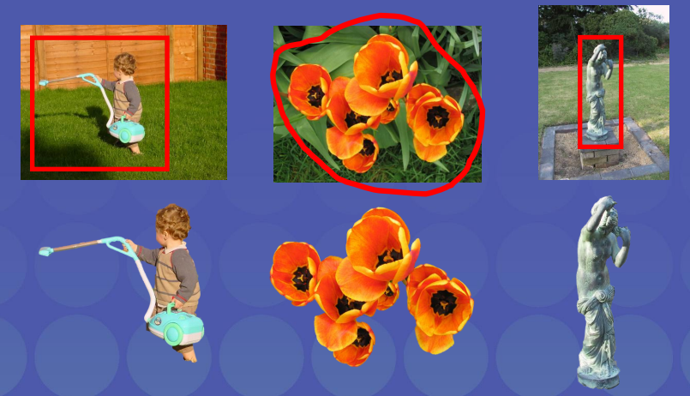
GrabCut samples

Slide 12
Introduction
Literature review
Problem statement
Interactive graph cut segmentation
Silent Lazy Snapping solution
Experimental results
Future direction
Question and answer

Slide 13
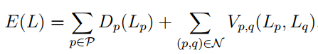
Binary labelling problem
Minimize the energy function (Greig et al., 1989)

Slide 14
Min-cut Max-flow problem

Slide 15
Introduction
Literature review
Problem statement
Interactive graph cut segmentation
Silent Lazy Snapping solution
Experimental results
Future direction
Question and answer

Slide 16
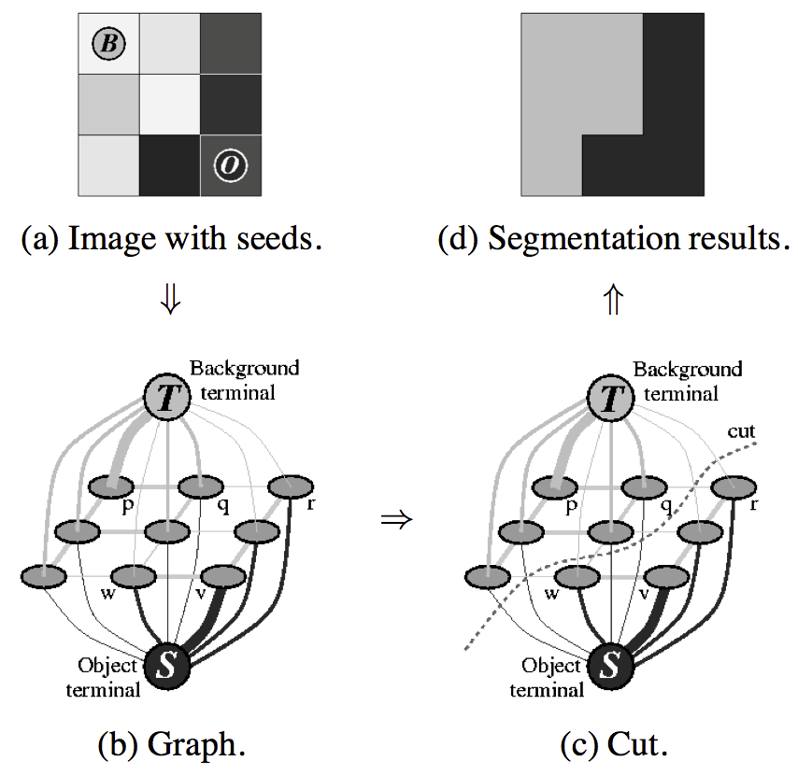
Graph cut construction
A simple segmentation example for a 3x3 image.

Slide 17
Energy function

Slide 18
Energy function (cont.)

Slide 19
Detailed implementation
Negative log-likelihood of intensity for regional term
Ad hoc function for boundary term
Max-flow algorithm provided by Boykov and Kolgomorov (2001)

Slide 20
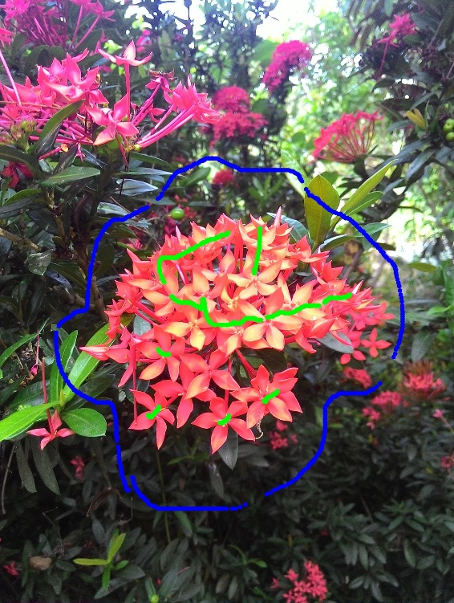

Sample result and comment

Slide 21
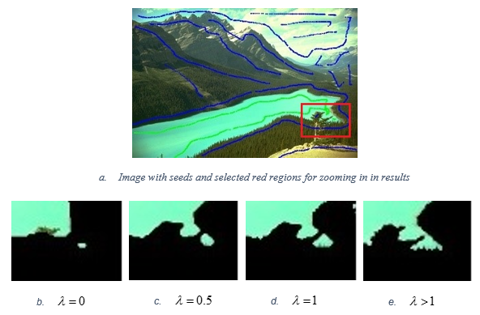
Sample result and comment (cont.)

Slide 22
Introduction
Literature review
Problem statement
Interactive graph cut segmentation
Silent Lazy Snapping solution
Experimental results
Future direction
Question and answer

Slide 23
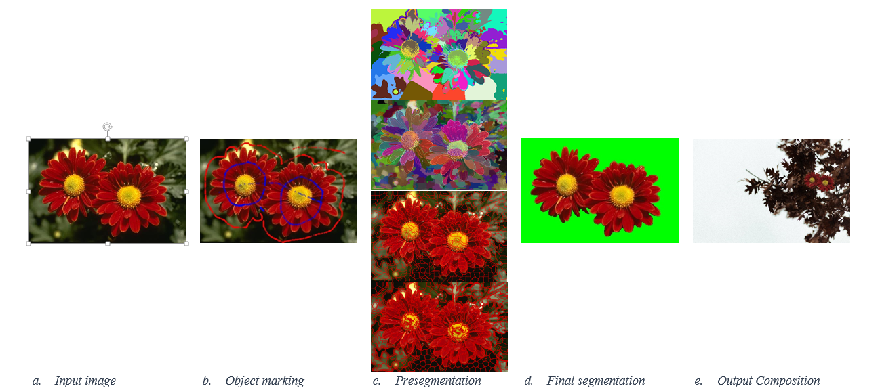
Silent Lazy Snapping model

Slide 24
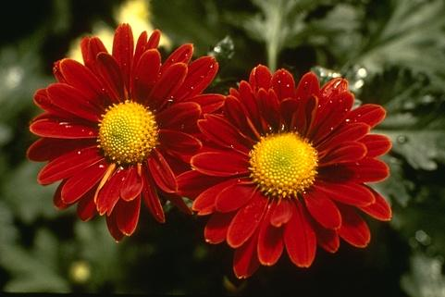
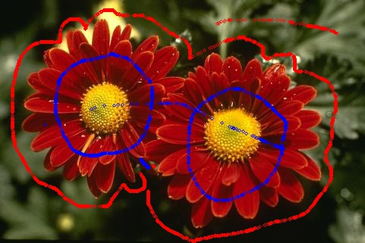
Step 1: Sample definition

Slide 25
Sample definition step
User action:
Visualize examples by drawing strokes/points in input image.

Slide 26
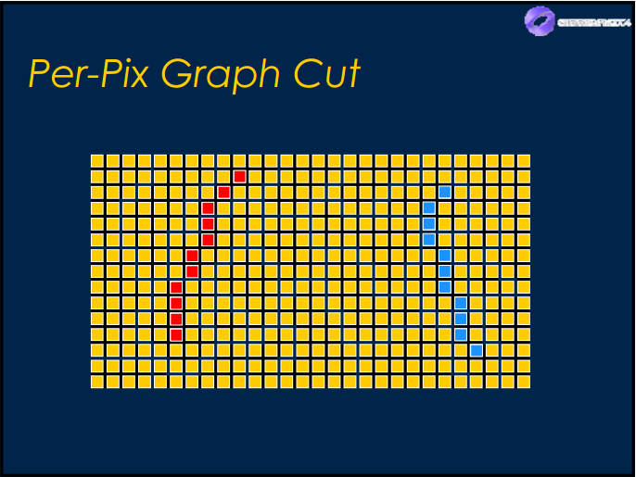
Sample definition step
Sample definition in pixel level:
Blue color: pixel belongs to foreground/object.
Red color: pixel belongs to background.

Slide 27

Step 2: Pre-segmentation by SEEDs algorithm

Slide 28
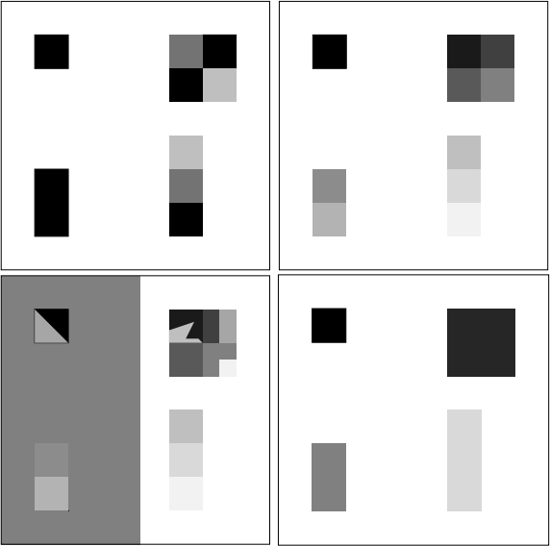
Over-segmentation: pixels belong to same object are classified as belonging to different segments. A single object may be represented by two or more segments.

Slide 29
Under-segmentation: pixels belong to different objects are classified as belonging to the same object. A single segment may contain several objects.

Slide 30

Pre-segmentation step K-means method (4124 segments)
Cannot control the number of segments.
Over-segmentation problem.
Easy to implement, but require time and memory.

Slide 31
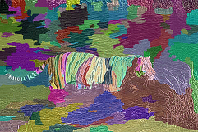
Pre-segmentation step Watershed method (212 segments)
Cannot control the number of segments.
Under-segmentation problem.
Unstable because result depends on threshold value.

Slide 32
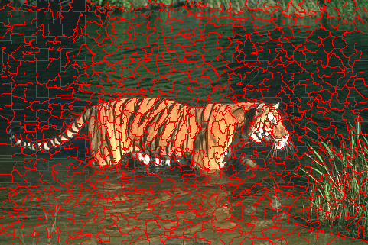
Pre-segmentation step SEEDs – Super pixel (800 segments)
Can control the number of segments.
Depend on the number of iteration.
Under-fitting boundary problem.

Slide 33
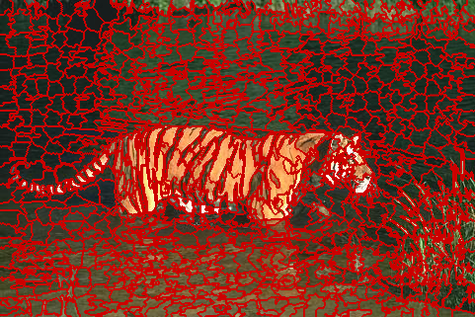
Pre-segmentation step SEEDs – Revised Mean Pixel (800 segments)
Can control the number of segments.
Depend on the number of iteration.
Stable, usable result.

Slide 34
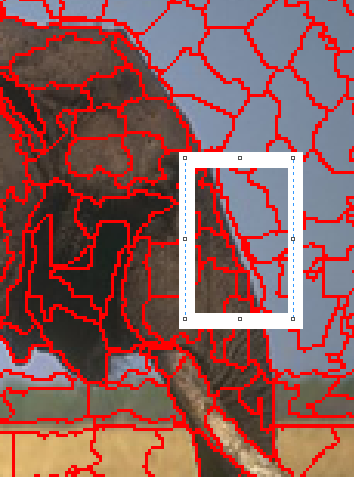
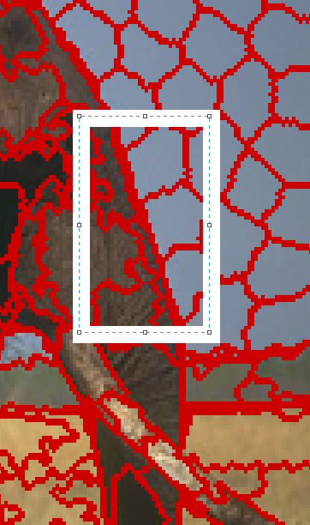
Comparison between SEEDs Super Pixel and SEEDs Revised Mean Pixel
SEEDs Super Pixel
SEEDs Revised Mean Pixel

Slide 35
Why SEEDs Revised Mean Pixels?
Can control the number of segments.
Can control the number of iteration.
Avoid over/under segmentation problem.
Avoid under-fitting boundary problem.
Linear complexity: O(5*N) (N – number of pixel in the original image)

Slide 36
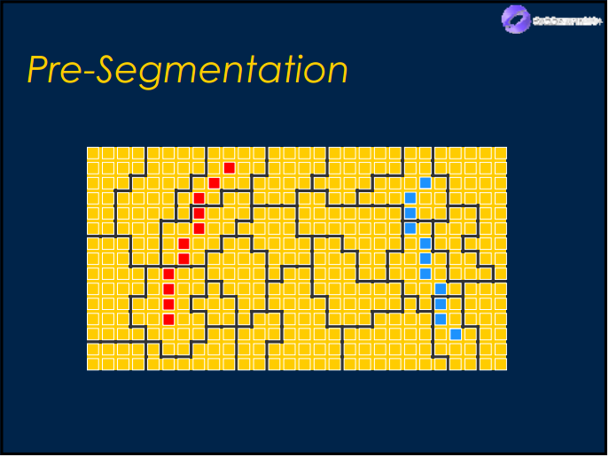
Pre-segmentation step
Segments combine with sample definition in pixel level:
Blue color: pixel belongs to foreground/object.
Red color: pixel belongs to background.

Slide 37
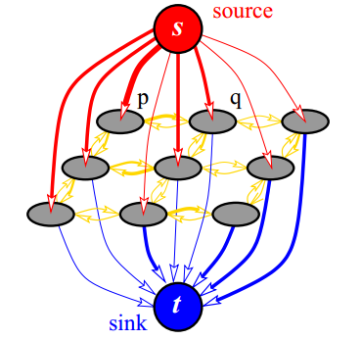
Step 3: Graph initialization

Slide 38
Introduction
Literature review
Problem statement
Interactive graph cut segmentation
Silent Lazy Snapping solution
Experimental results
Future direction
Question and answer

Slide 39
Introduction
Literature review
Problem statement
Interactive graph cut segmentation
Silent Lazy Snapping solution
Experimental results
Future direction
Question and answer

Slide 40
Graph Cut for Interactive Segmentation
Use other feature descriptor
Add options to GUI for easier experimenting

Slide 41
Silent Lazy Snapping
Add boundary editing function
Combine other filter to deal with noise

Slide 42
Introduction
Literature review
Problem statement
Interactive graph cut segmentation
Silent Lazy Snapping solution
Experimental results
Future direction
Question and answer

Slide 43
THANK YOU FOR LISTENING!

